Slide 1
Understanding Data(Cont)
21/3/2019

Slide 2
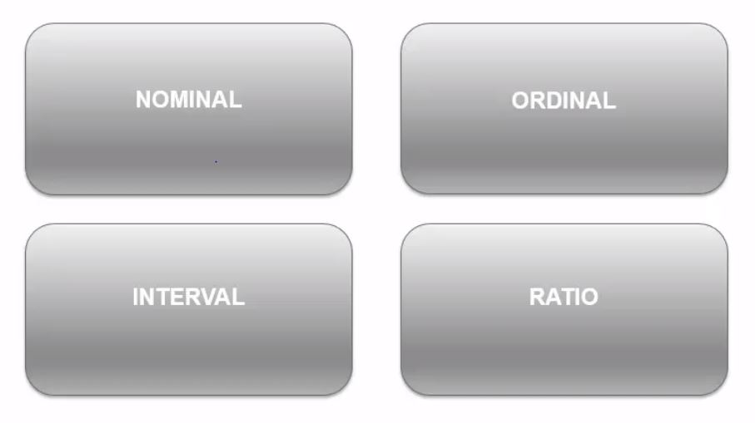
Data Attributes
Attributes helps us to gain the complete understanding of data and helps us to interact with data.
The four attributes are mentioned below

Slide 3
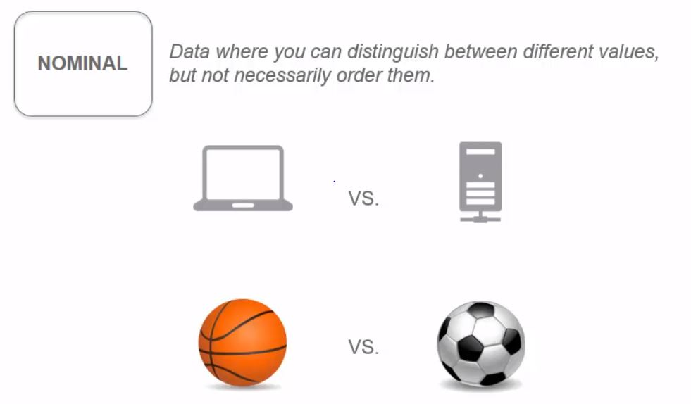
Nominal data

Slide 4
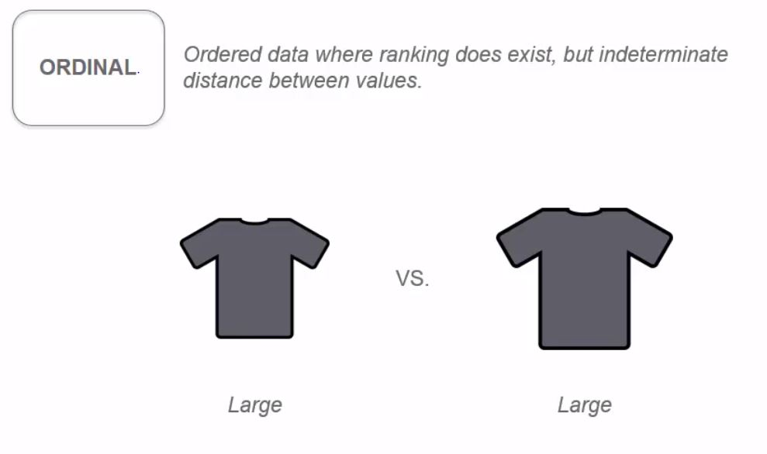
Ordinal data

Slide 5
Qualitative data
Both nominal and ordinal data are Qualitative data.
Nominal data not need to draw conclusions based on the statistical data for the comparing elements.
Ordinal data orders data. But it is indeterminate. For example, it just orders the shirt based on the size like Small, Medium, Large etc., But it does not consider the fact that Large size between two brands might be different.

Slide 6
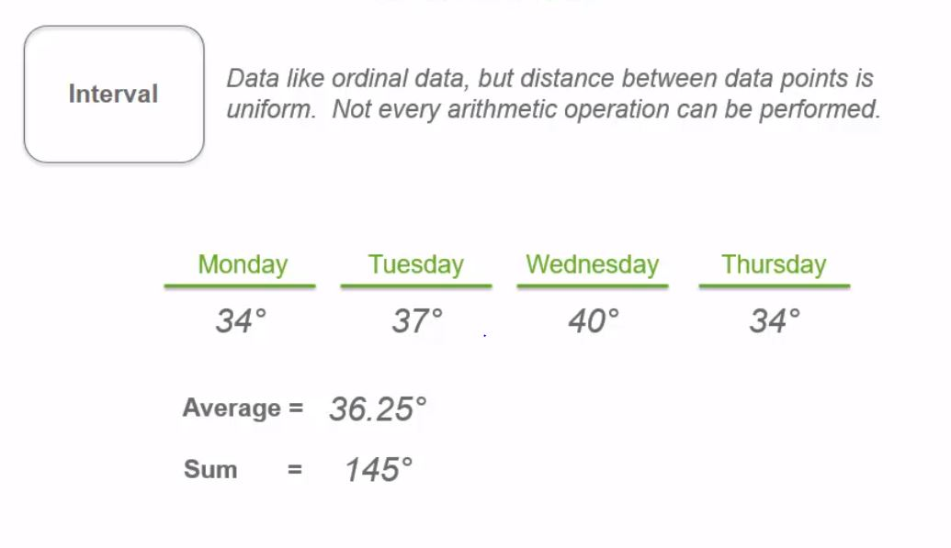
Interval data

Slide 7
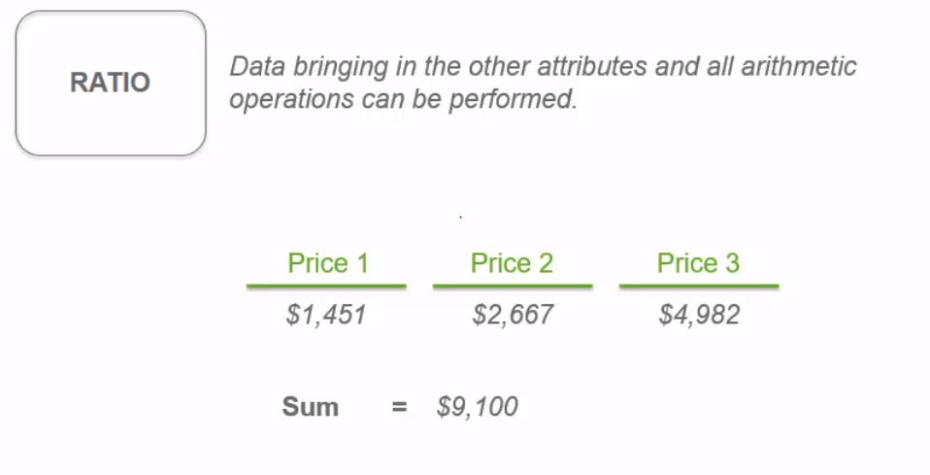
Ratio data

Slide 8
Quantitative data
Interval and ratio data are quantitative data.
In Interval data, the nature of the data points remain same in all the cases. But it can’t perform all the arithmetic operations.
For example, for the temperature data of 4 days, it will make sense if you calculate the average, but not the sum.
Ratio data is deferred from interval data by the fact that it can perform all the arithmetic operations.

Slide 9
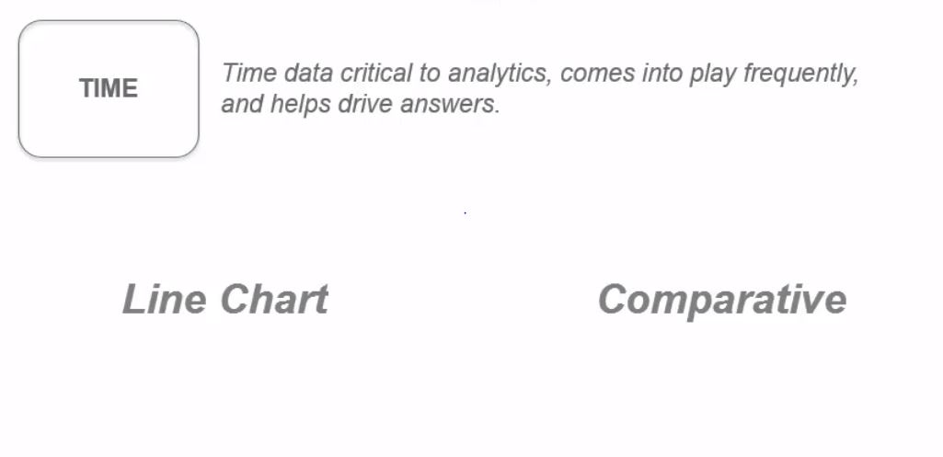
Time

Slide 10
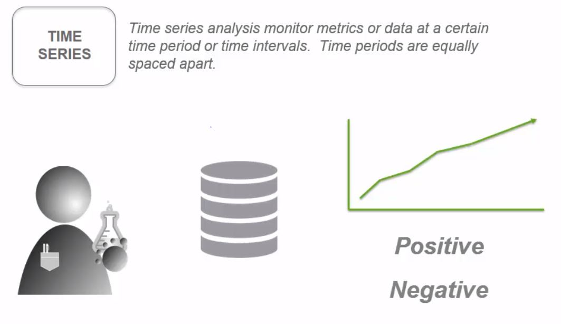
Time series

Slide 11
Time series
It analyze data over certain range of same time period.
Let us consider a scenario that we are going to do analysis for the effect of drug over a certain virus that affects people of certain region.
We first start with collecting data about the impact of this virus on those people for last few days.
Create a visualization with this data, on number of people affected each day.
It will show a gradual increase on the graph, as it is spreading to everyone.
But after the drug is tested on them, if the graph still increases, it means the drug is not creating an impact and the result is negative. Vice versa for the decline of the graph.

Slide 12
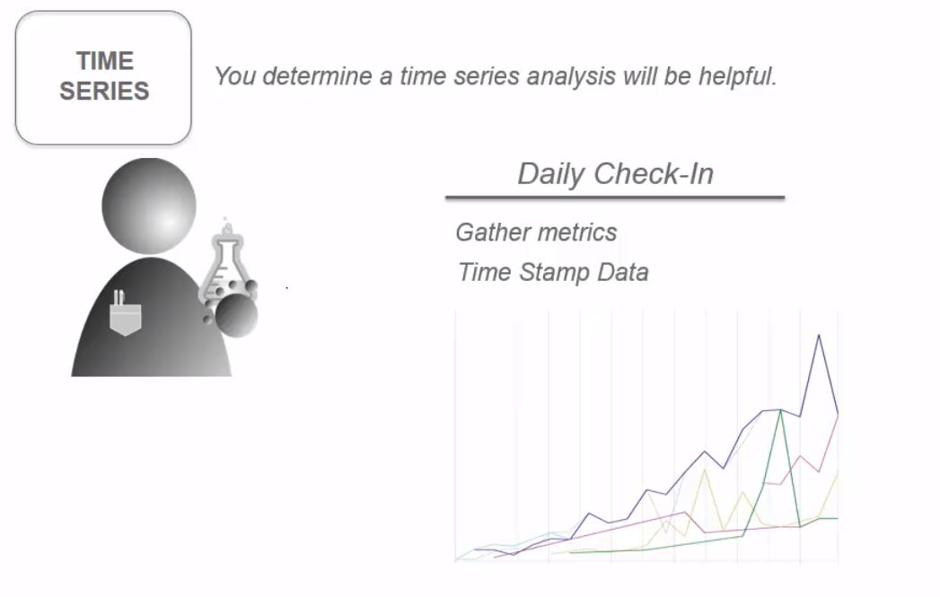
Collecting data

Slide 13
Collecting data
For the given scenario, consider the fact that we are going to collect data from a patient on a regular basis, using daily check up on the same time.
Collect information like temperature, symptoms and ask other series of questions, which will be the metrics.
Create visualization on single patient using daily data, and find observations from that graph, whether there is an increase or decline of the graph and produce results.

Slide 14
Why this learning matters?
It will be helpful in studying the back end, where data is stored and processed, which then make the communication with your data administrator easier and effective.
Every organization obtains data from different source and it is the job of the back end to make sure the front end user obtains readable and usable data.
For example, if we are going to create a time stamp visualization and the data from the back end is designed poorly or incorrect, no matter how good your visualization and analytical knowledge is, you will end up in giving a false analysis

Slide 15
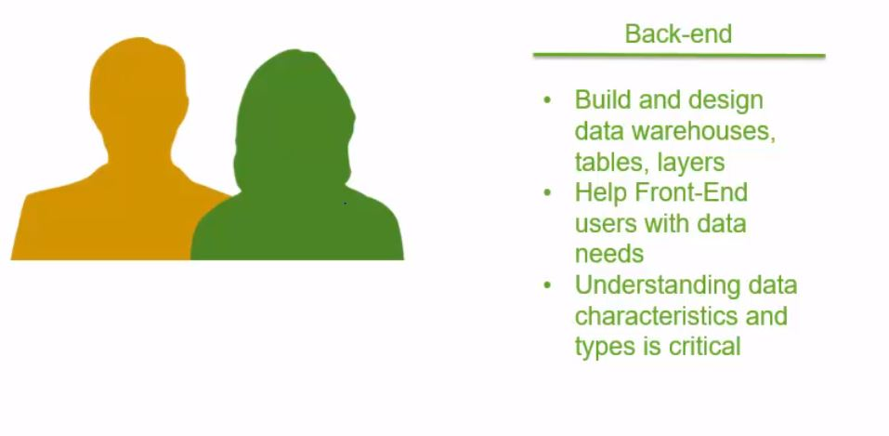
Impact on back end

Slide 16
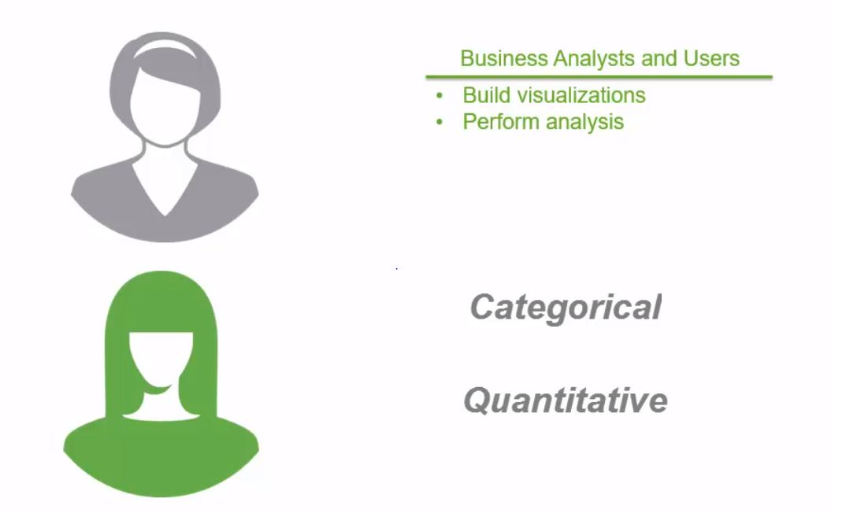
Impact on front end

Slide 17
Impact on front end
One of the reason to have this data knowledge for front end user is, it will helps in selecting the accurate data for creating visualizations.
Other reason is to interact with data administrator.
Consider a scenario that you are asked to create an analytical report of sales of last 12 months data and to compare that with forecast.
You need to know the type of the data available, whether it is categorical or quantitative.
Few categorical data for the given scenario are month, product, region and quantitative data are sales, margin.
After knowing the data, you need to know the type of the chart we are going to use for this scenario.

Slide 18
Line chart Vs Pie chart
For a trend analysis of 12 months of data, it is recommended to use line chart over pie chart, as it will give detailed explanation.
But for the region wise data for a particular month, the sales can be shown in pie chart .

